Slide 1







Improving Visual Prompt Tuning by Gaussian Neighborhood Minimization for Long-Tailed Visual Recognition
The 38 Annual Conference on Neural Information Processing Systems
DECEMBER 10-15, 2024 VANCOUVER, CANADA
Mengke Li, Ye Liu, Yang Lu, Yiqun Zhang, Yiu-ming Cheung, Hui Huang*
Reported by Ye Liu

Slide 2
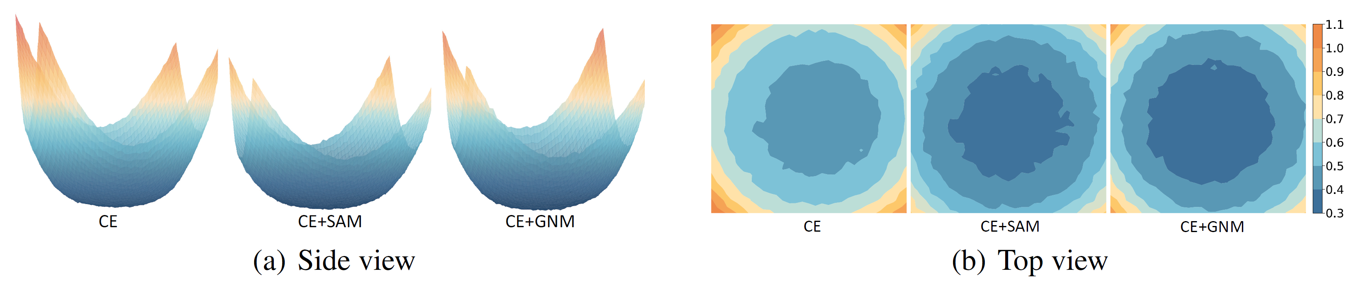
Introduction
SAM (Pierre et al. 2021) improves model generalization by flattening minima.
Its generalization performance is impacted by imbalanced data distributions
Motivation:
Flatten loss landscape to enhance model generalization.
Introduce distribution-independent perturbation.
Pierre F, Ariel K, Hossein M, and Behnam N. Sharpness-aware minimization for efficiently improving generalization. In ICLR, 2021.

Slide 3
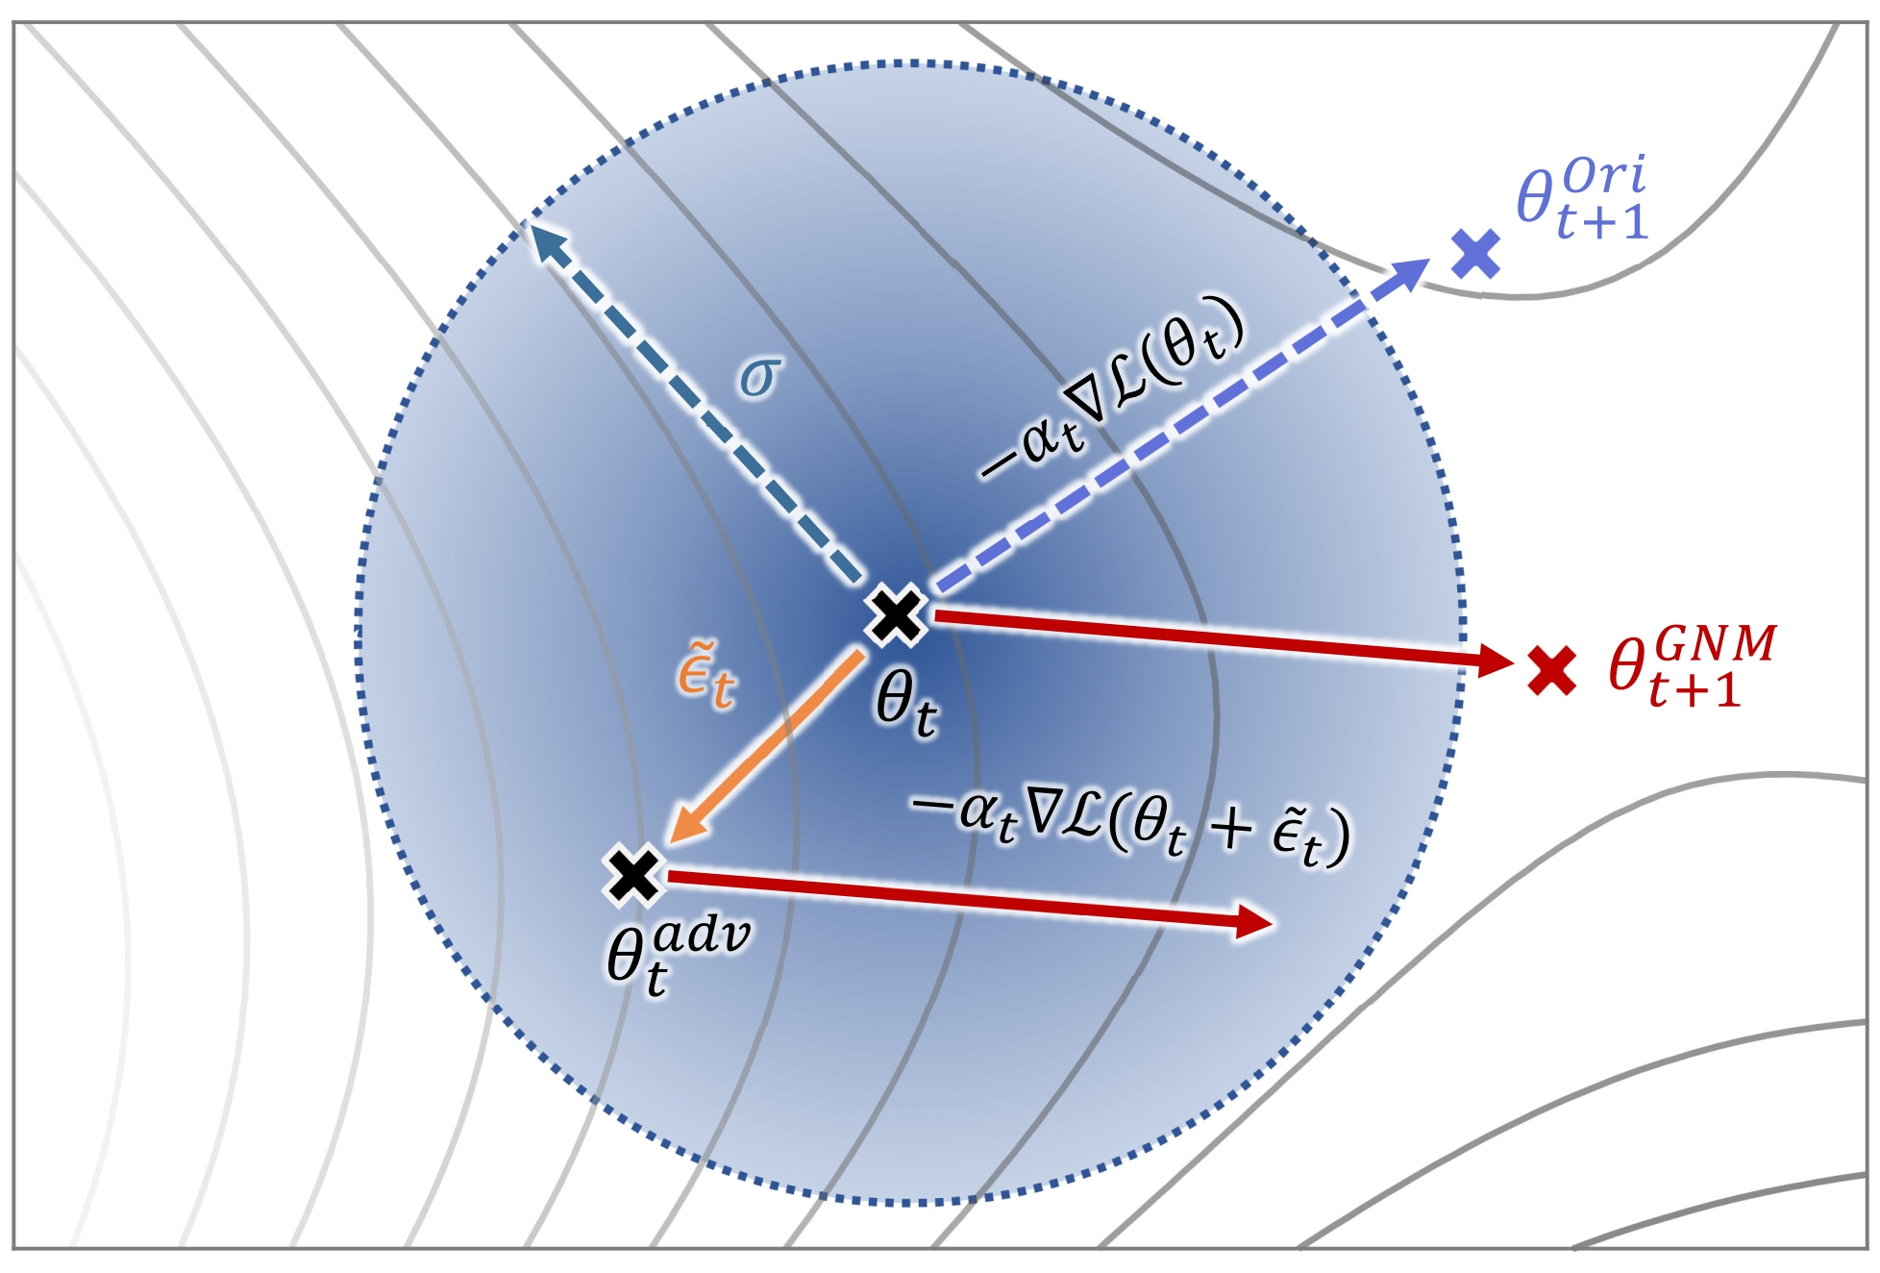
Method
Gaussian neighborhood loss:
Parameter update strategy:

Slide 4
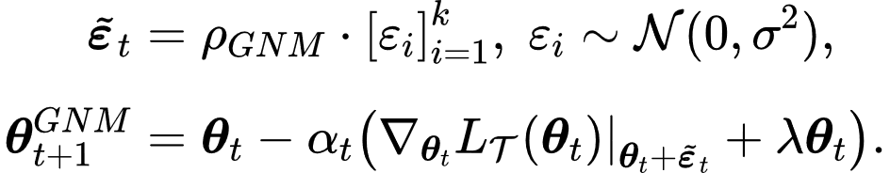
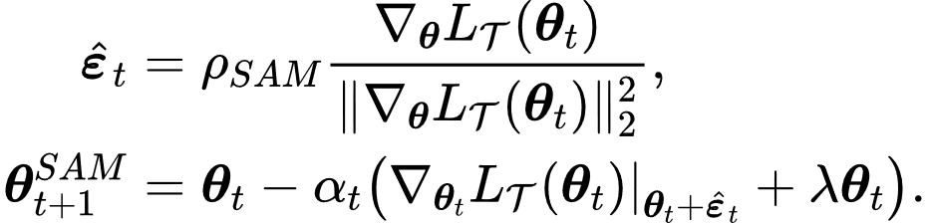
Analysis
Comparison of parameter update strategies between GNM and SAM :
GNM
SAM
Our proposed GNM:
Is well-suited for long-tailed data. GNM is in sample-independent manner .
Saves computational overhead. The parameter update in GNM does not need additional forward and backward pass to calculate perturbations.

Slide 5
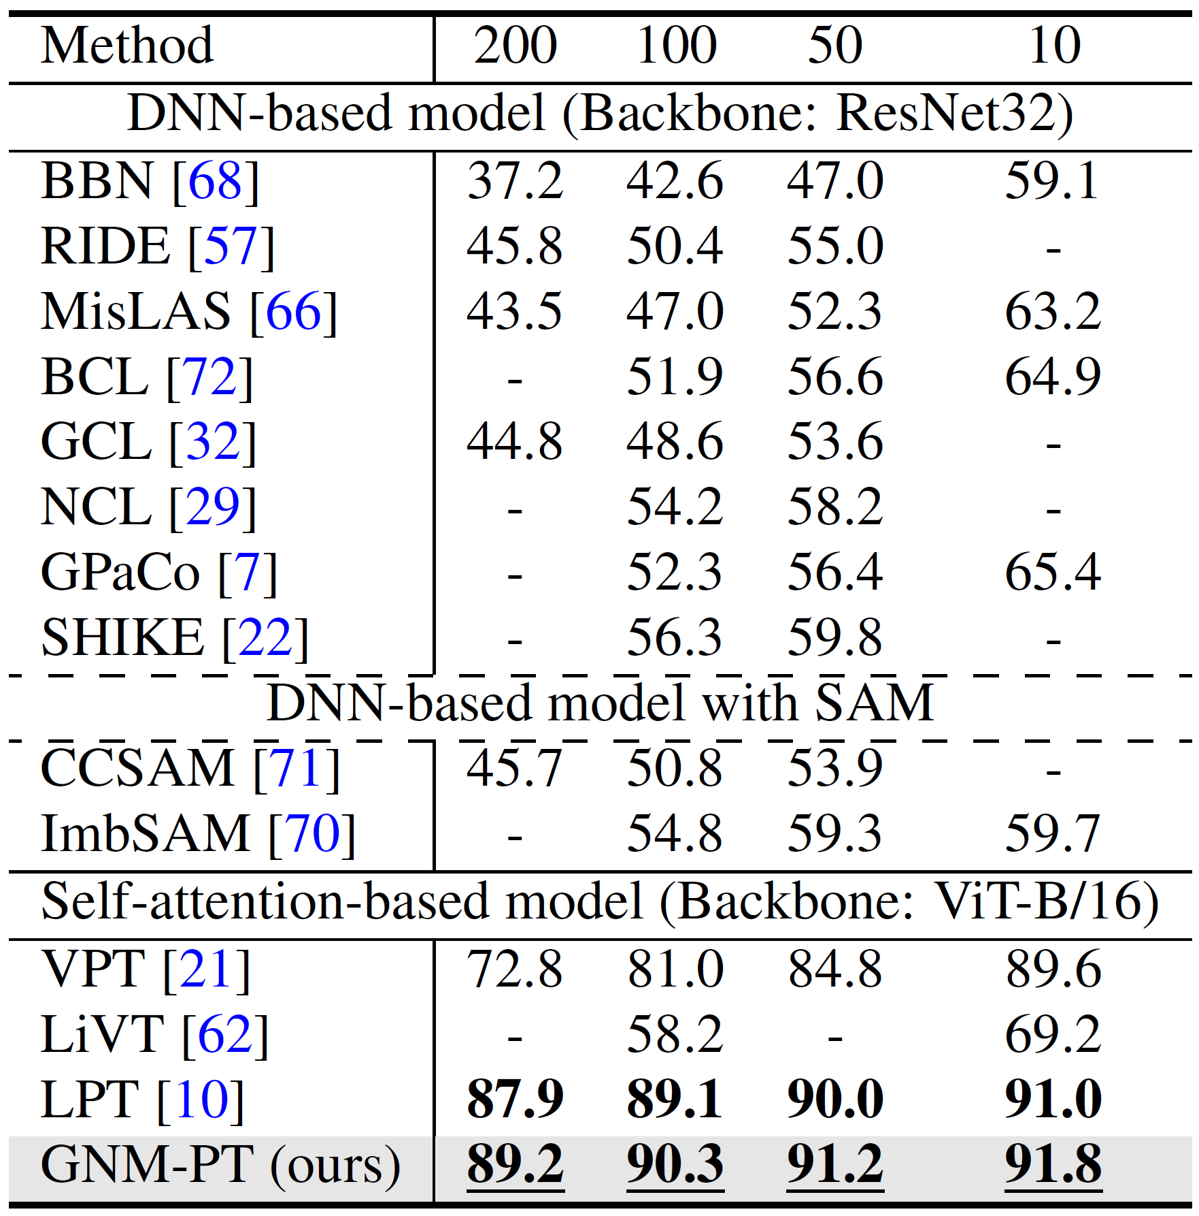
Experiments
Comparison results on CIFAR100-LT

Slide 6
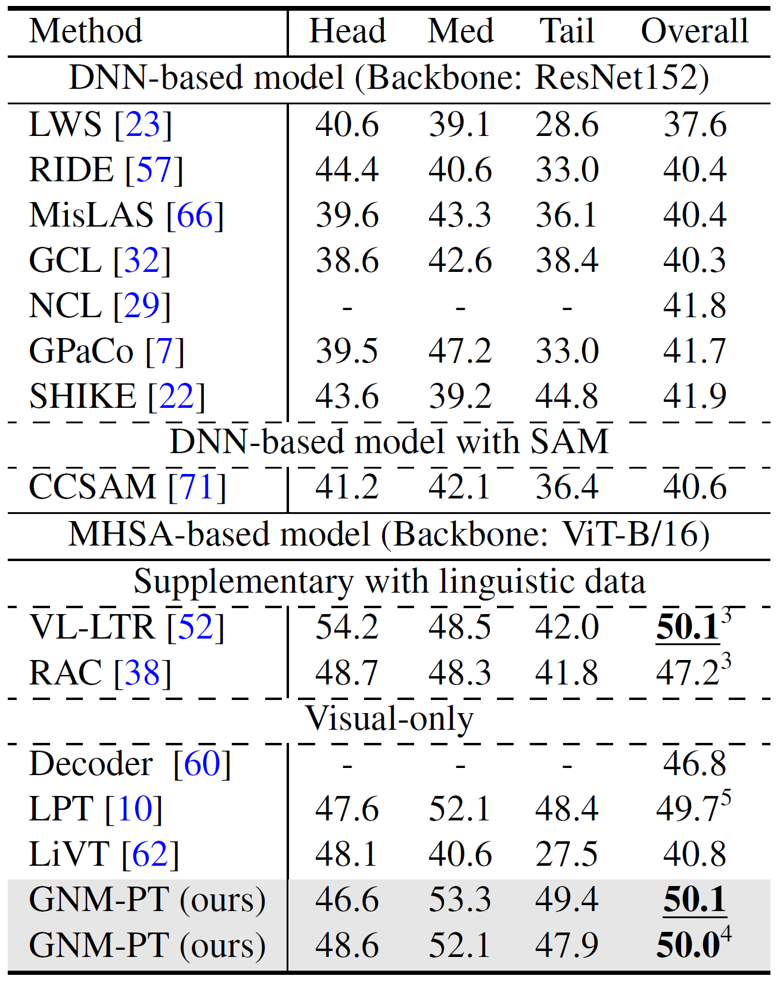
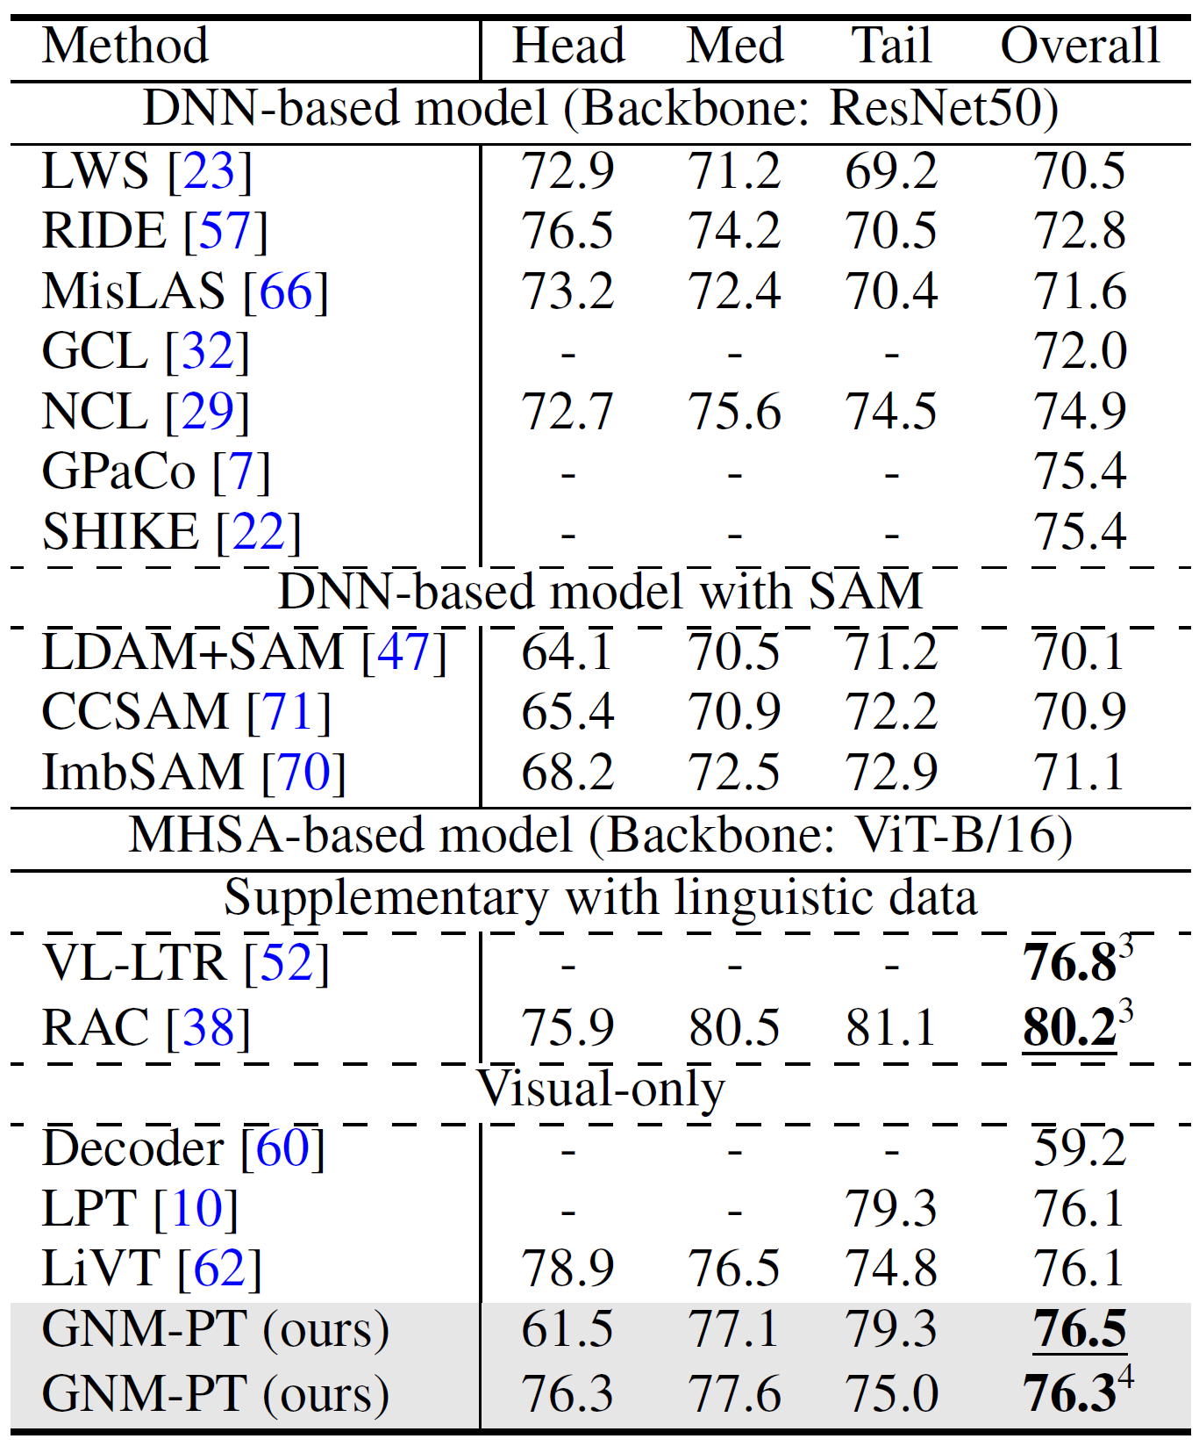
Experiments
Comparison results on Places-LT and iNaturalist 2018.

Slide 7
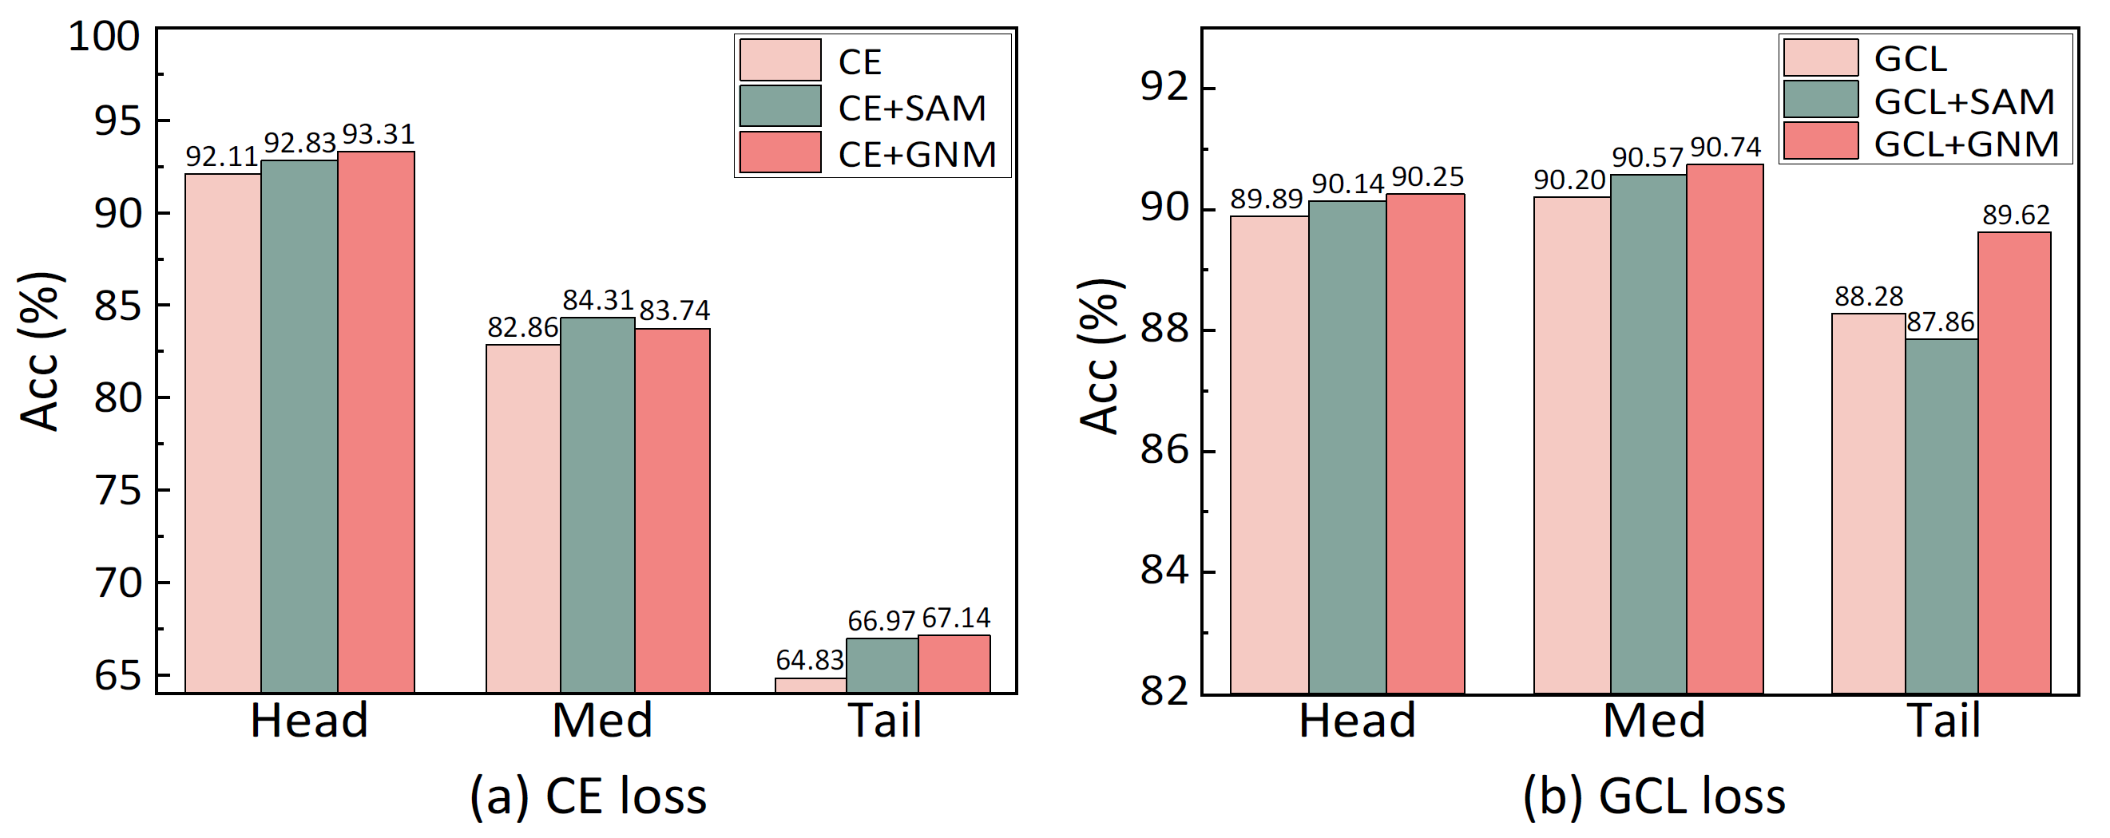
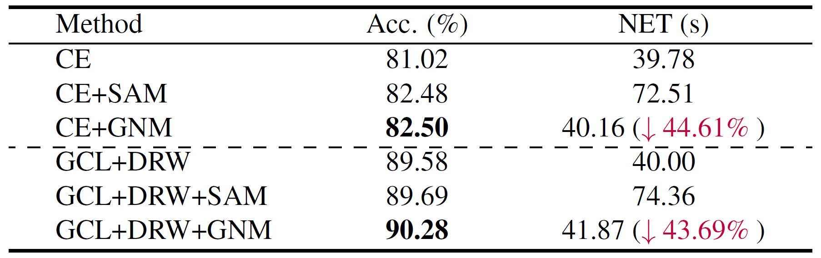
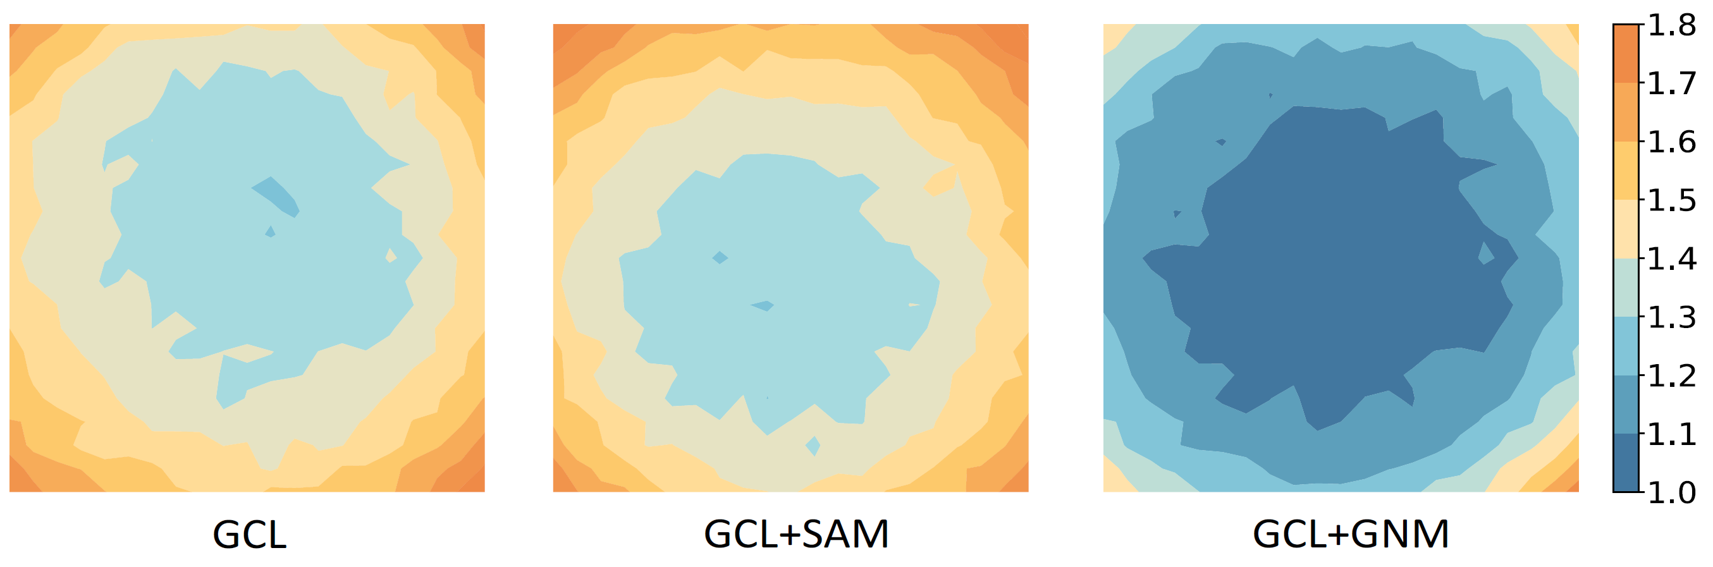
Experiments
Save computational overhead
Consistently enhance the performance of GCL across all categories in every scenario.
Achieve a flat loss landscape.

Slide 8
Conclusion
Pros:
Simple and effective:
Balance the generalization capabilities of both head and tail classes;
Little additional computational cost.
Cons:
Need to further re-balancing the classifier:
A rebalancing strategy is also needed to obtain a more balanced classifier.

Slide 9




Thanks
More details: http://arxiv.org/abs/2410.21042
Code: https://github.com/Keke921/GNM-PT
Contact: limengke@gml.ac.cn; zbdly226@gmail.com

